Slide 1
Relational Algebra

Slide 2
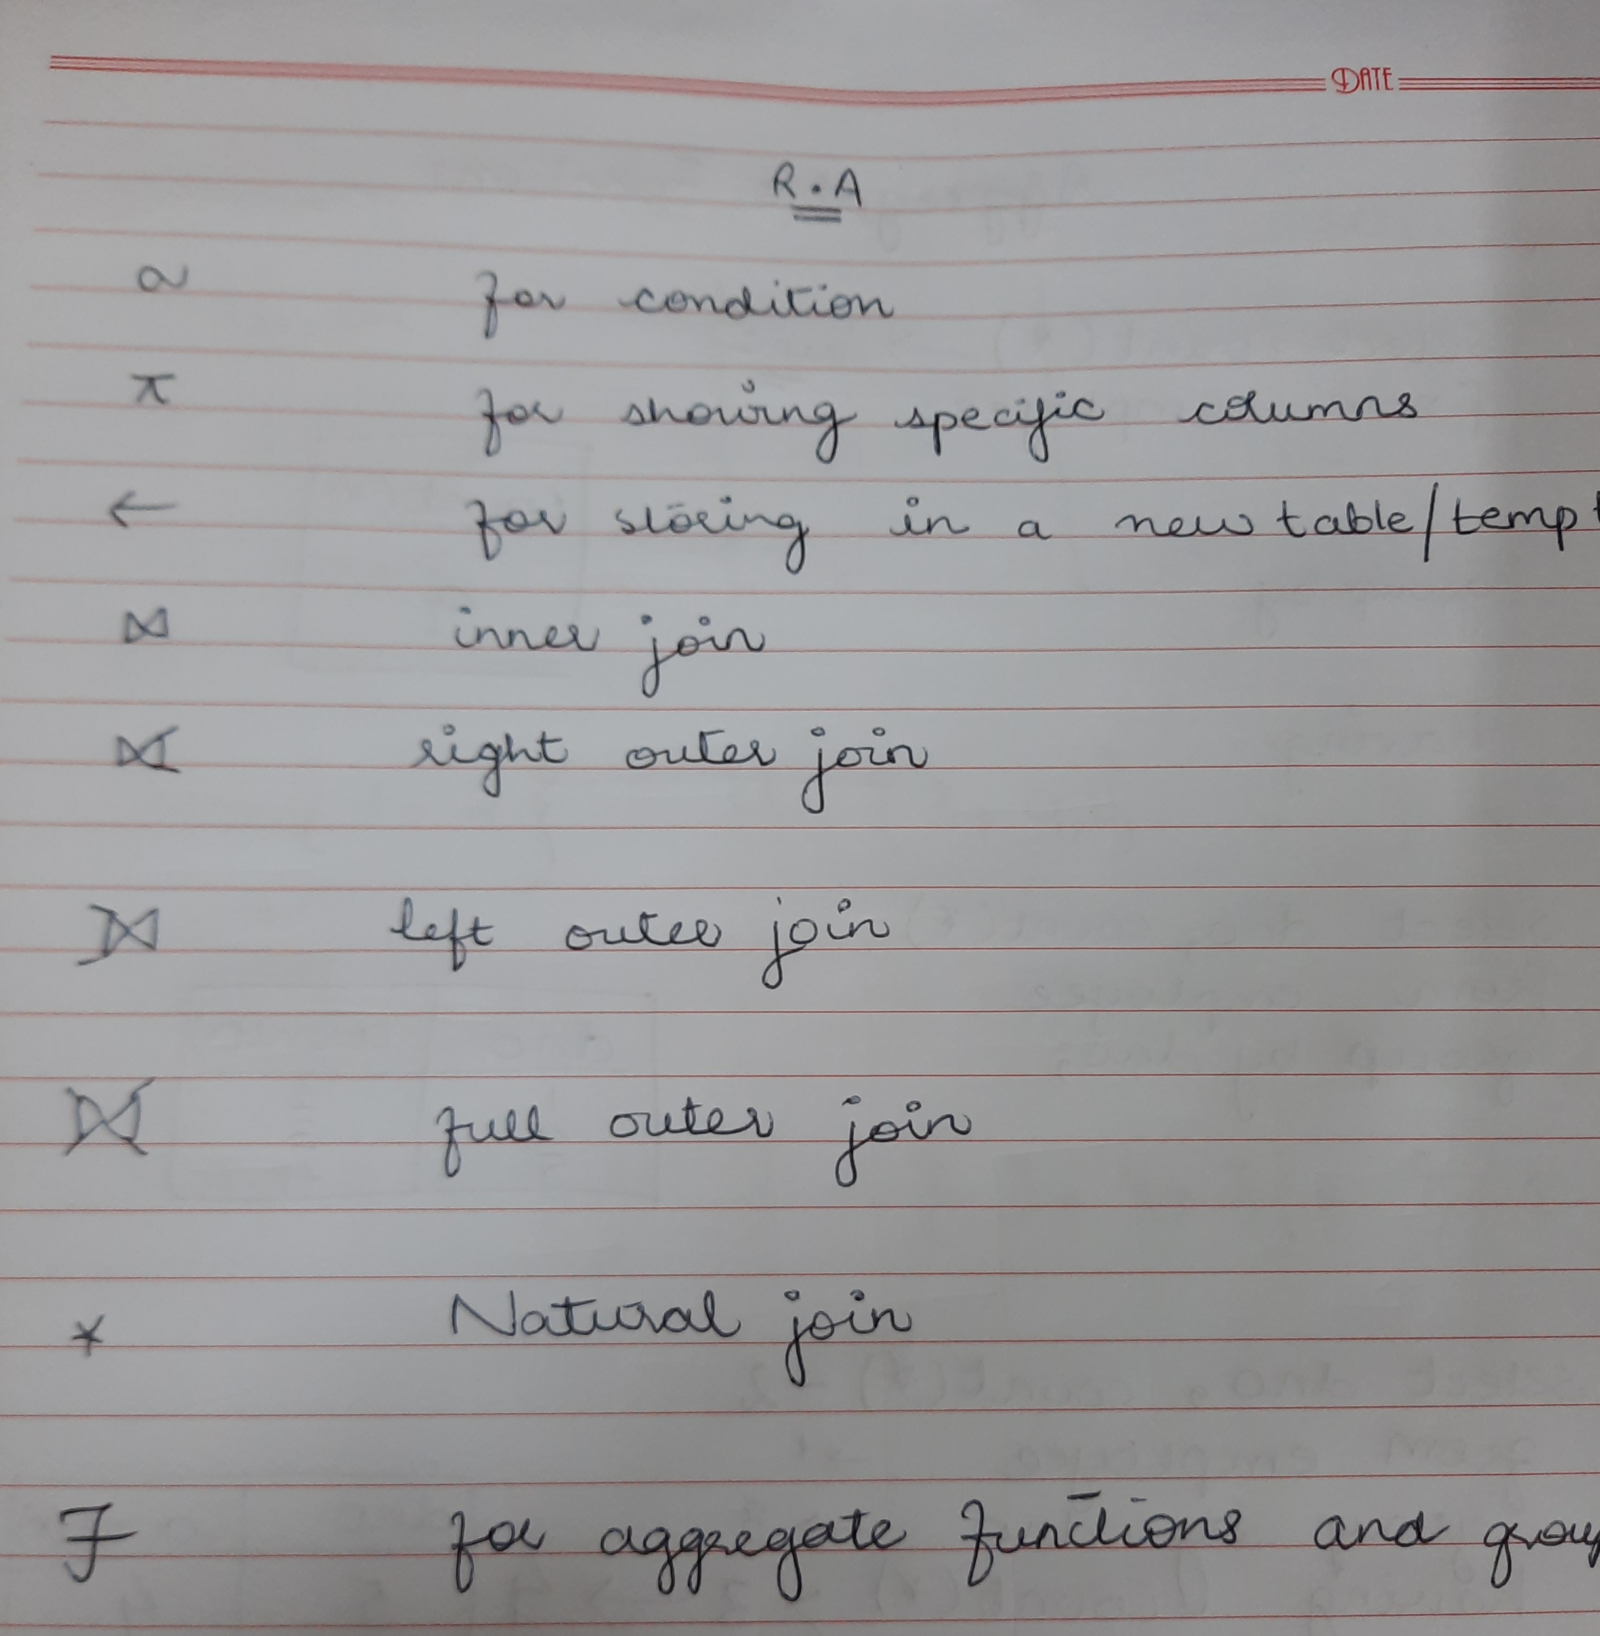
Operators in RA

Slide 3
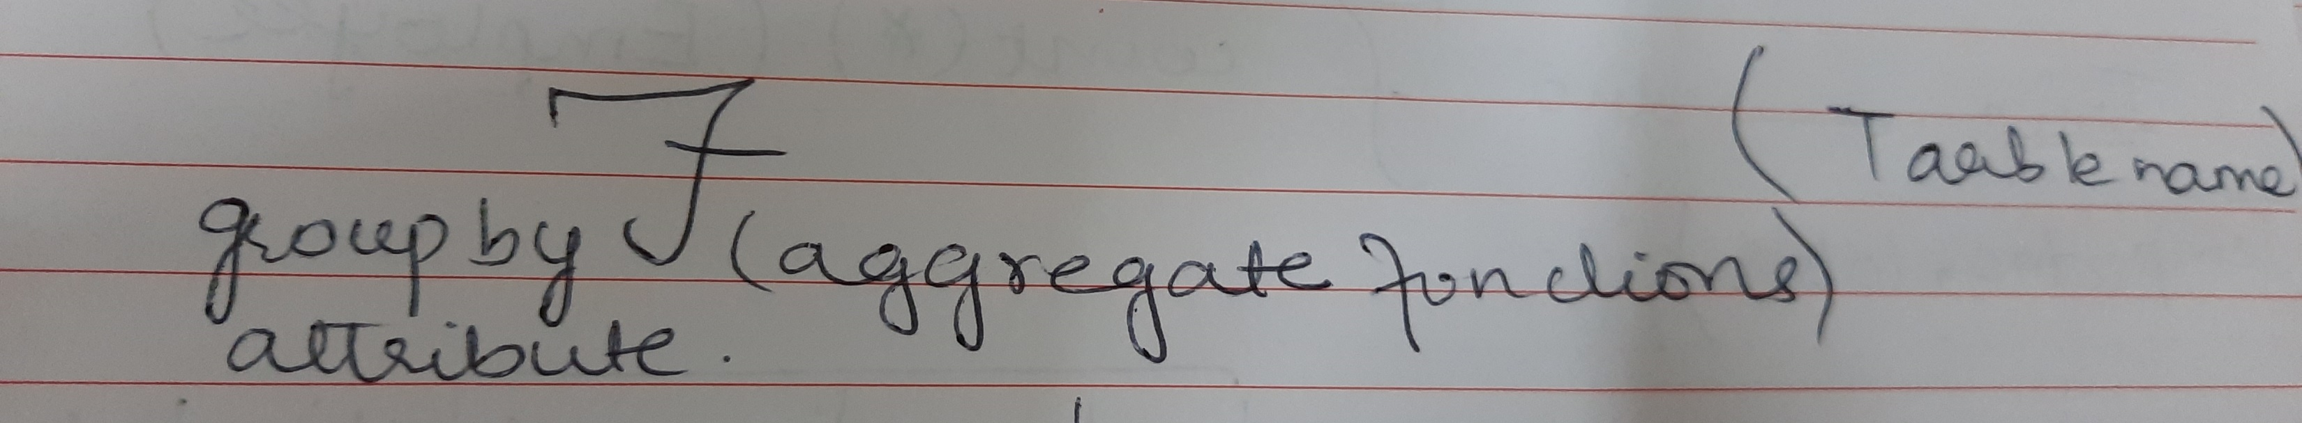
Aggregate Functions

Slide 4
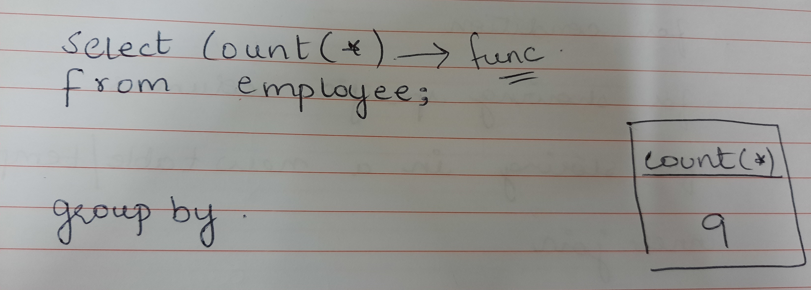
Aggregate Functions

Slide 5
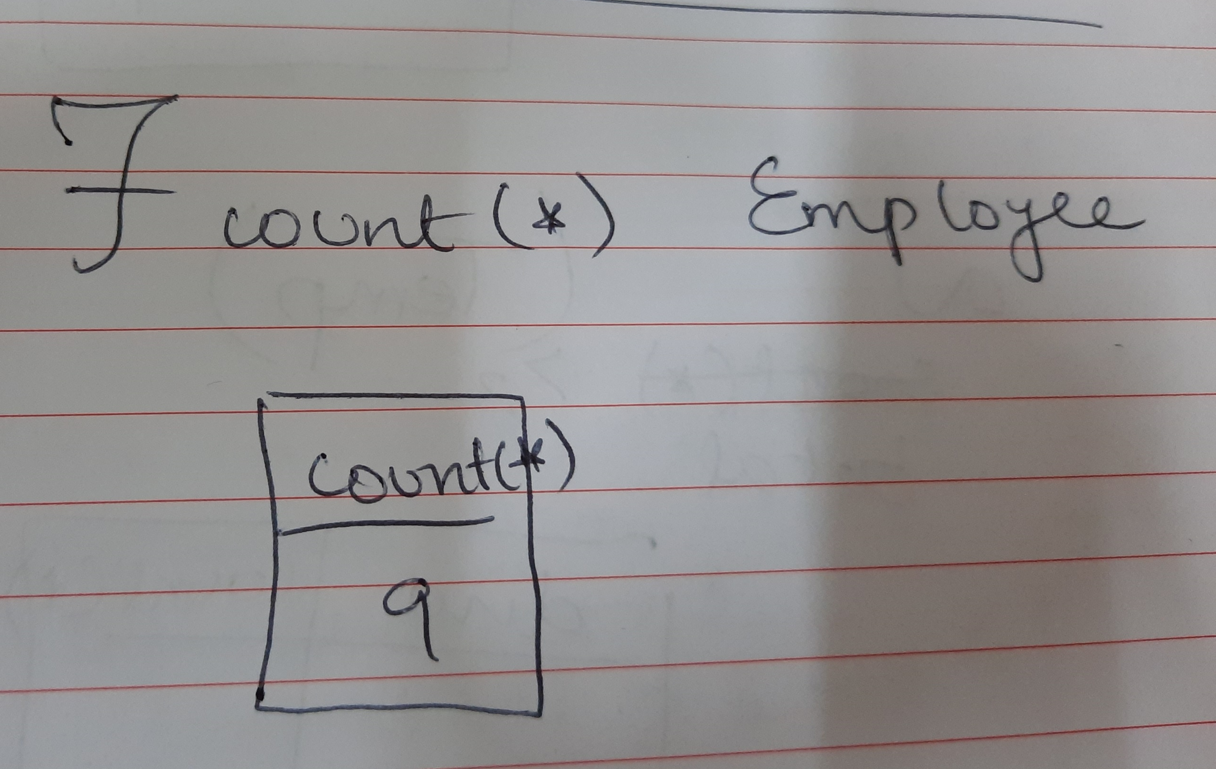
Show how many employees are working in the company?

Slide 6
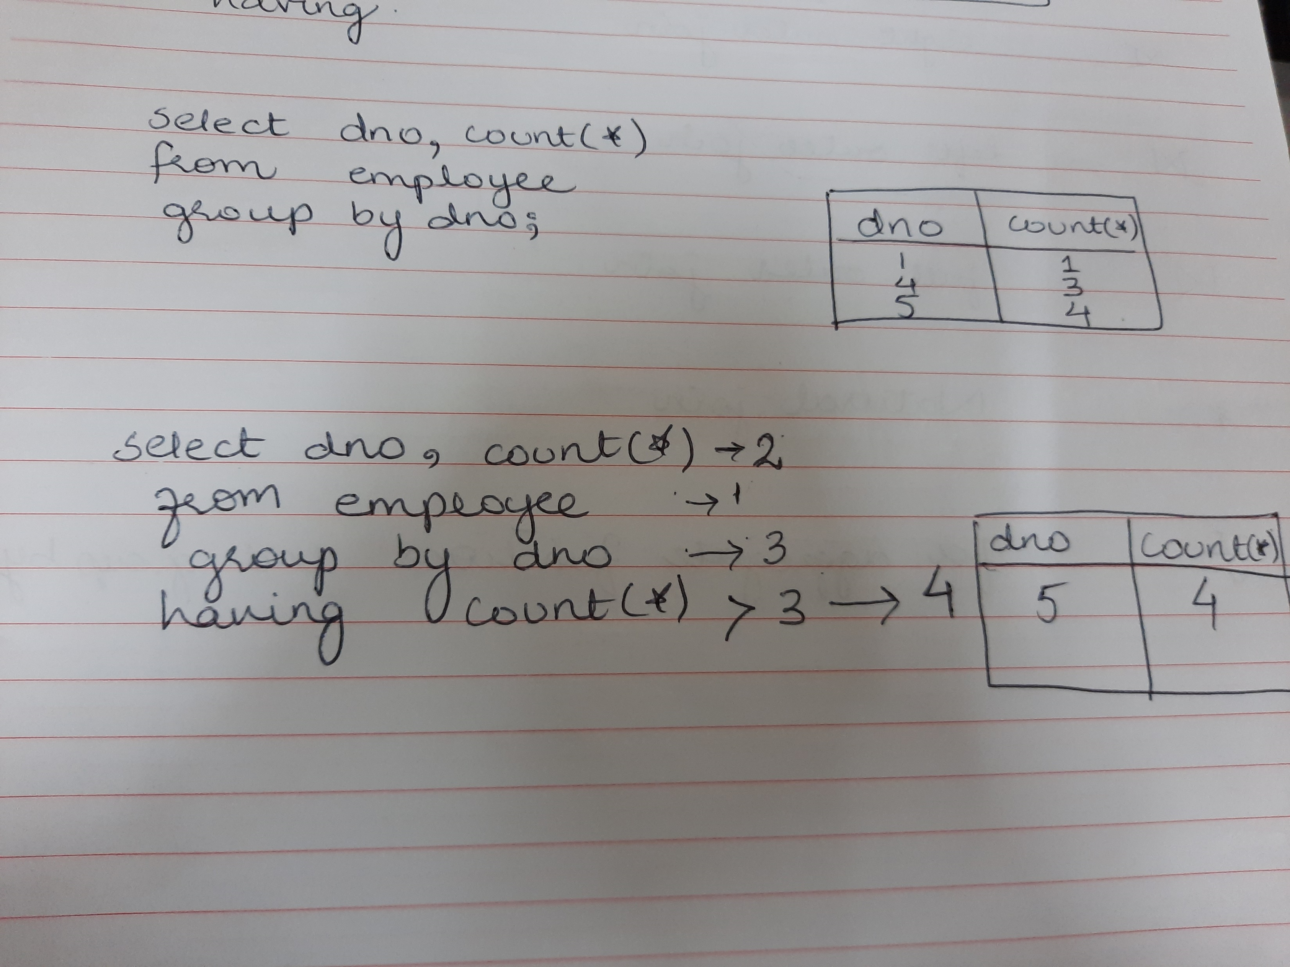
Aggregate Functions

Slide 7
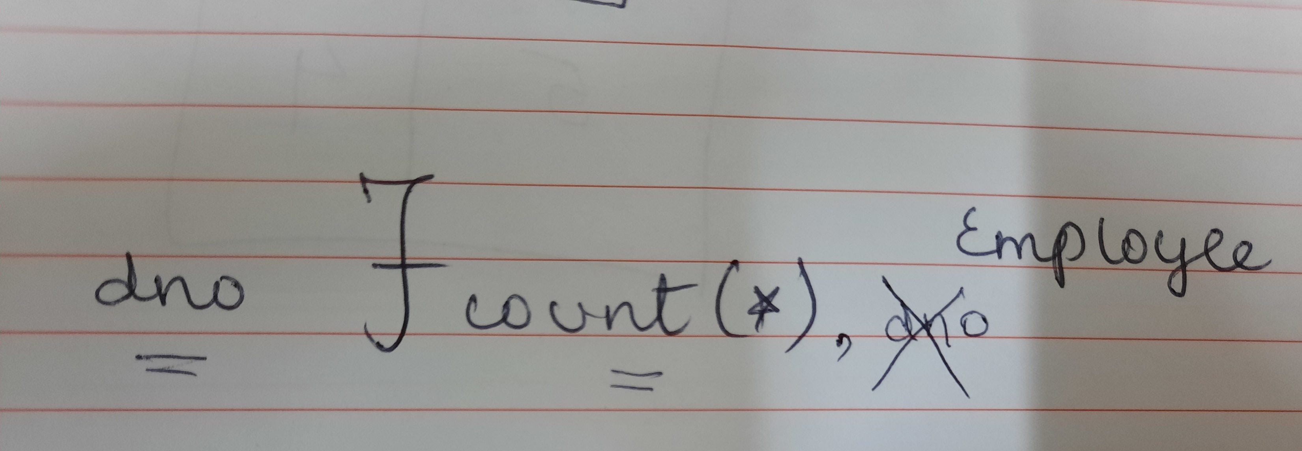
Show how many employees are working in each department.

Slide 8
For each department show the total number of people working in that department only if it has more than 3 employees.

Slide 9
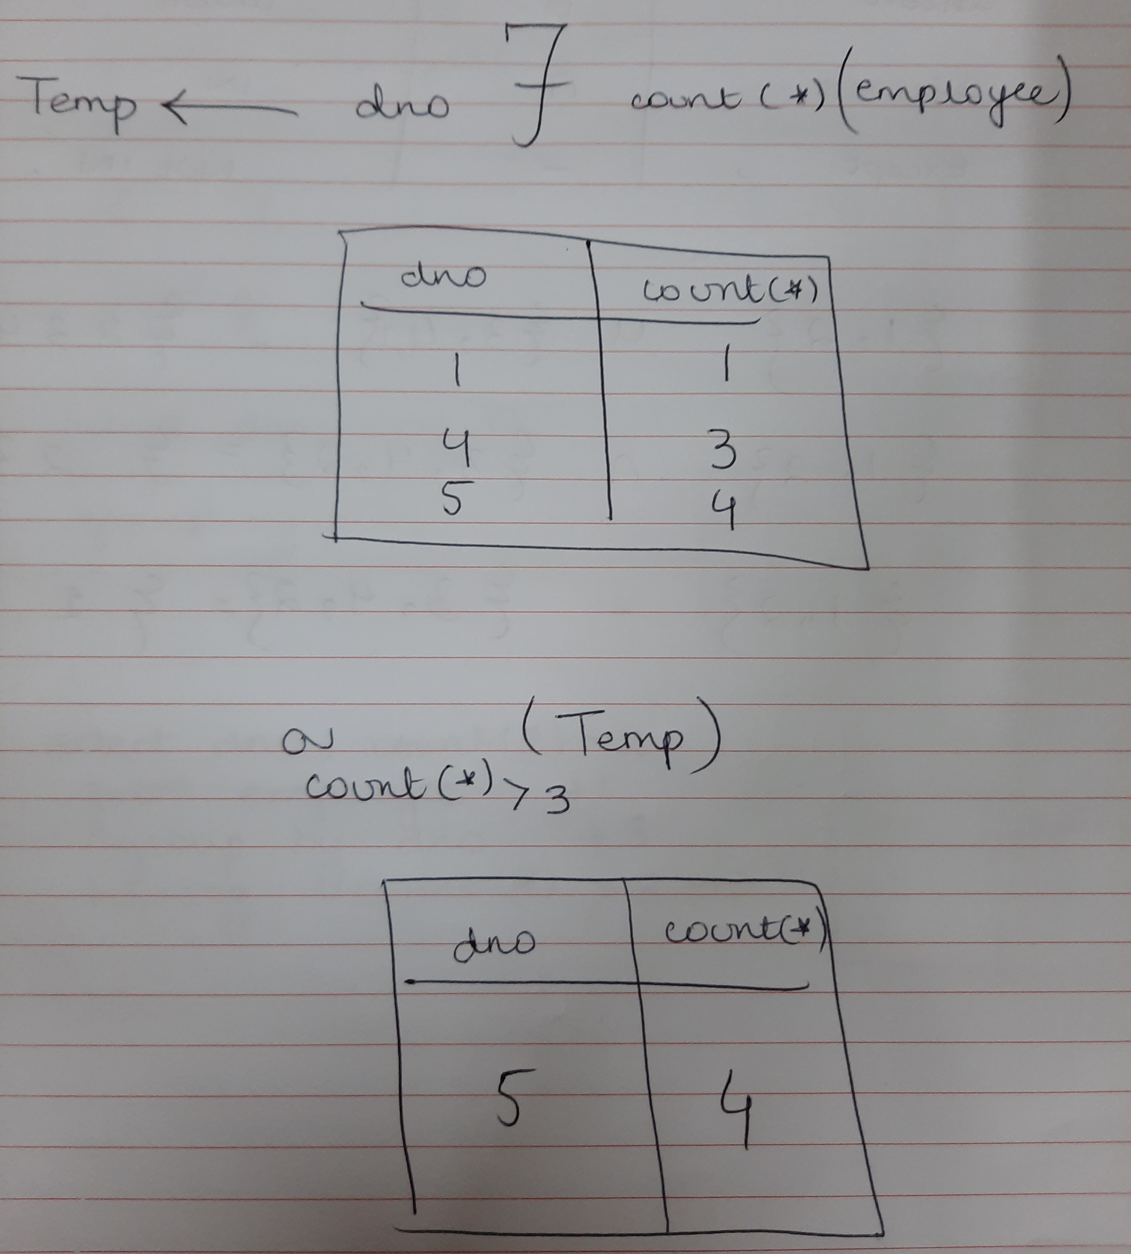
For each department show the total number of people working in that department only if it has more than 3 employees.

Slide 10
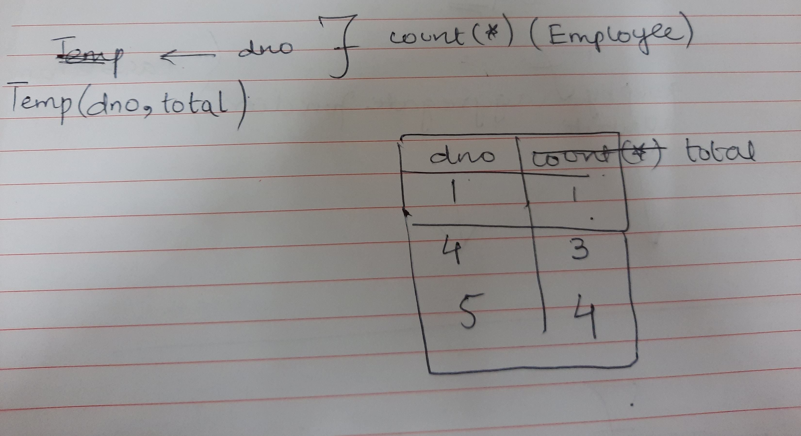
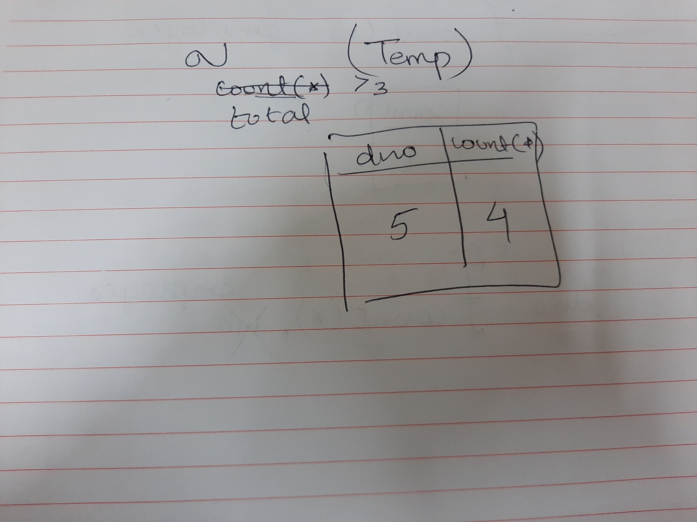
For each department show the total number of people working in that department only if it has more than 3 employees.

Slide 11
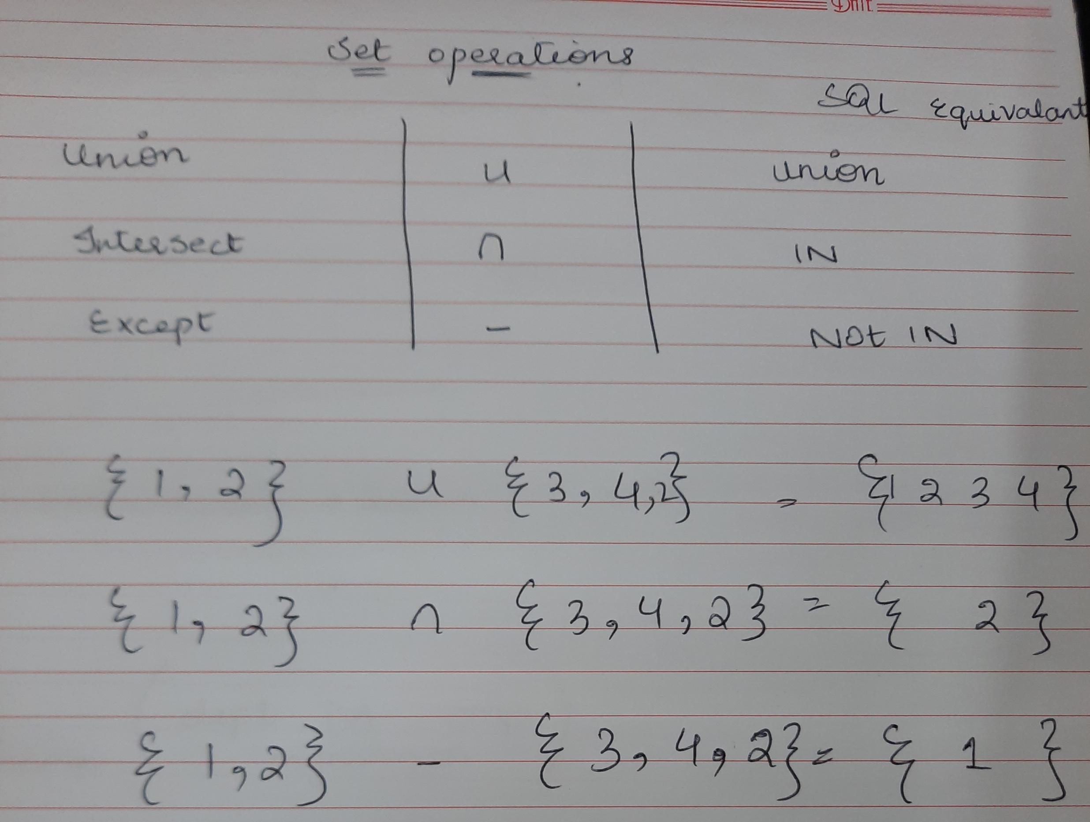
Set operations

Slide 12
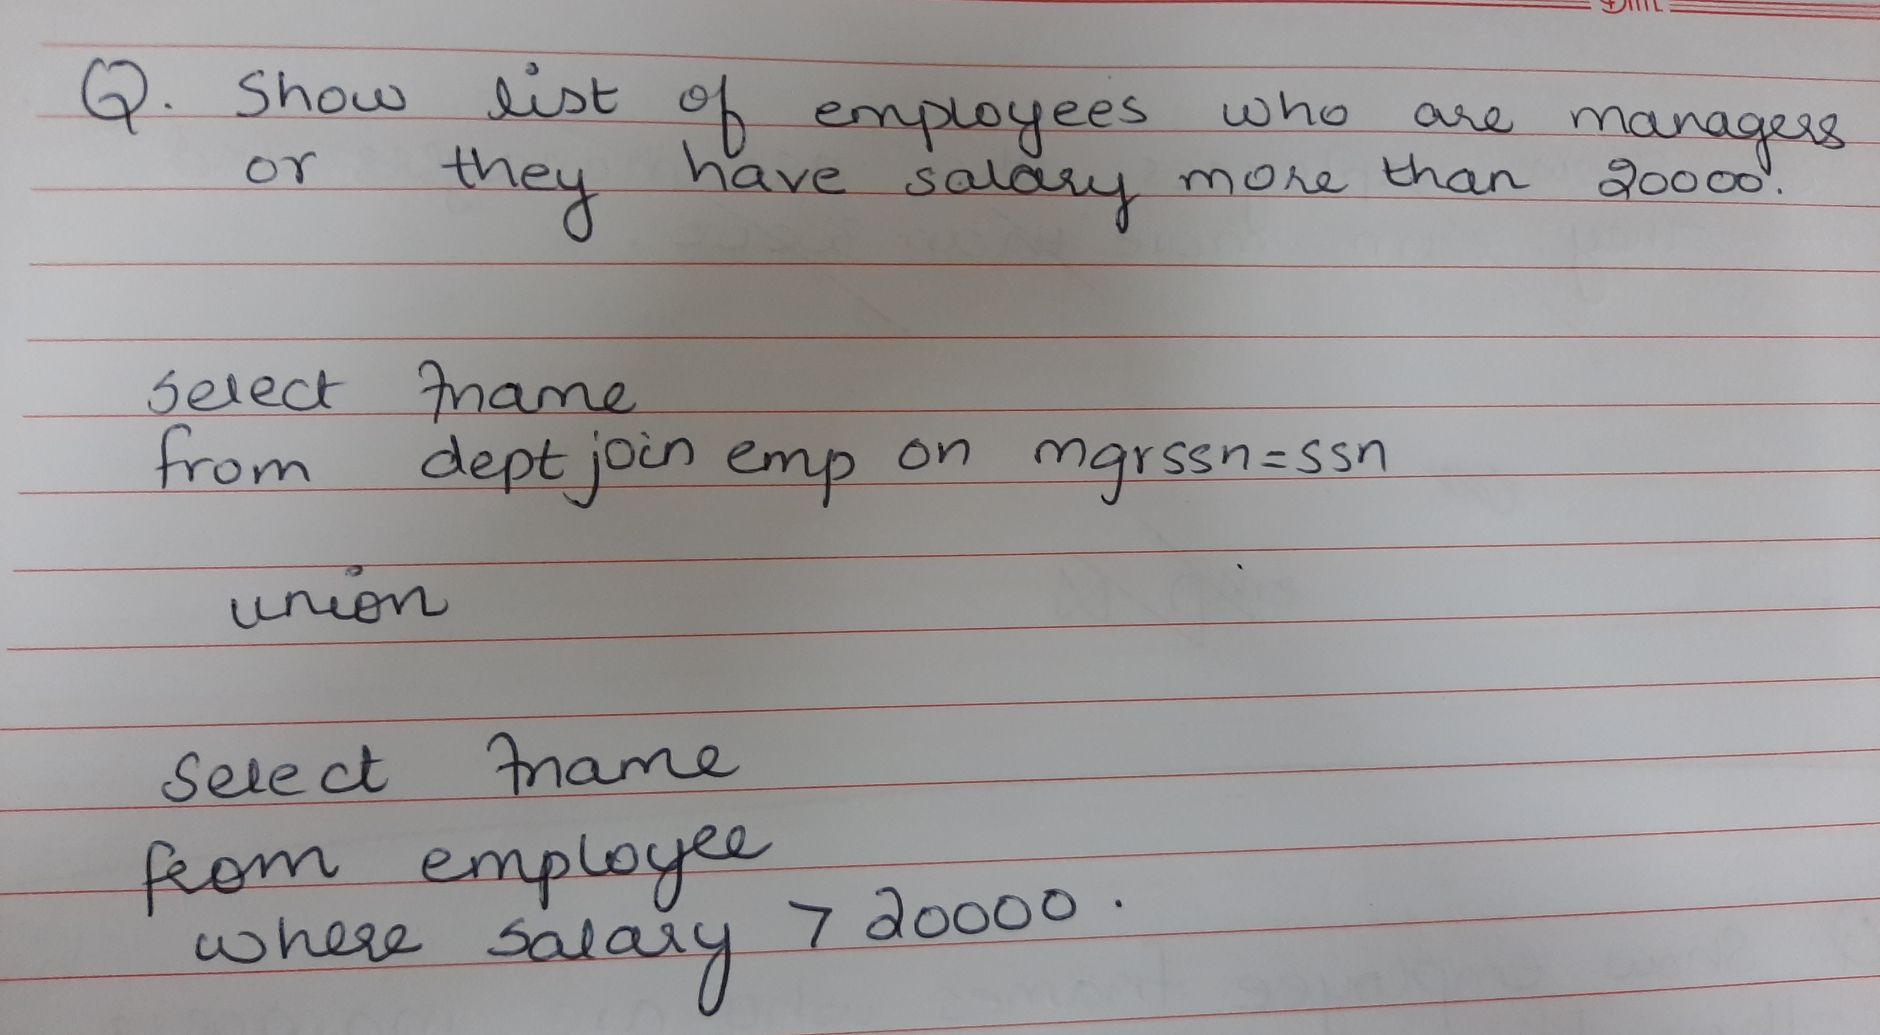
Union

Slide 13
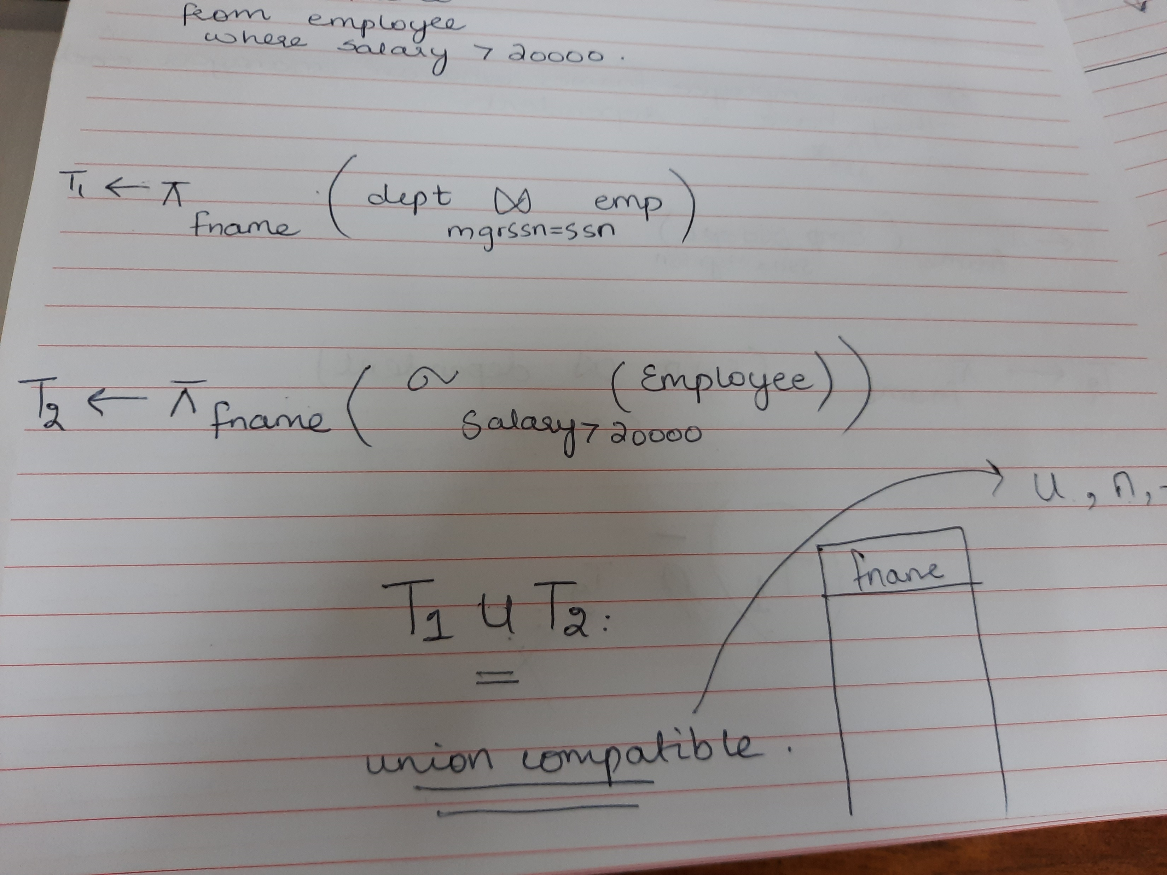
Union

Slide 14
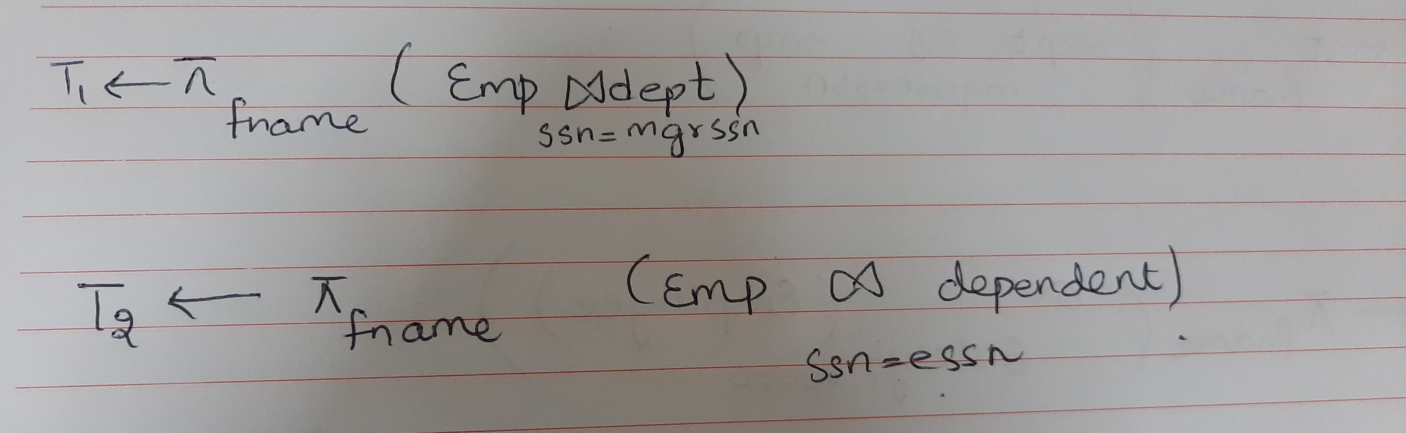
Intersection
Show employees who are managers and they have a dependent.
T1 n T2

Slide 15
Minus/Except/Set Difference
Show employees who are managers but they don’t have a dependent.
T1 - T2

Slide 16
Examples of Queries in Relational Algebra
Q1: Retrieve the name and address of all employees who work for the ‘Research’ department.
Q2. For every project located in ‘Stafford’, list the project number, the controlling department number, and the department manager’s last name, address, and birth date.
Q3 Make a list of project numbers for projects that involve an employee whose last name is ‘Smith’, either as a worker or as a manager of the department that controls the project. (use UNION)
Q4. List the names of all employees with two or more dependents.
Q5: Retrieve the names of employees who have no dependents.
Q6. List the names of managers who have at least one dependent. (USE INTERSECTION)

